Slide 1
Day 21
Kalman Filter Examples

Slide 2
Tank of Water
static level
plant model
measurement model

Slide 3
Tank of Water
filling at a (noisy) constant rate and we do not care about the rate
u_{t} is the change in the water level that occurred from time t-1 to t
plant model
measurement model

Slide 4
Tank of Water
filling at a (noisy) constant rate and we want to estimate the rate
plant model
measurement model

Slide 5
Projectile Motion
projectile launched from some initial point with some initial velocity under the influence of gravity (no drag)

Slide 6
Projectile Motion
convert the continuous time equations to discrete recurrence relations for some time step

Slide 7
Projectile Motion
rewrite in matrix form

Slide 8
Omnidirectional Robot
an omnidirectional robot is a robot that can move in any direction (constrained in the ground plane)
http://www.youtube.com/watch?v=DPz-ullMOqc
http://www.engadget.com/2011/07/09/curtis-boirums-robotic-car-makes-omnidirectional-dreams-come-tr/
if we are not interested in the orientation of the robot then its state is simply its location

Slide 9
Omnidirectional Robot
a possible choice of motion control is simply a change in the location of the robot
with noisy control inputs

Slide 10
Differential Drive
recall that we developed two motion models for a differential drive
using the velocity model, the control inputs are

Slide 11
Differential Drive
using the velocity motion model the discrete time forward kinematics are
Eqs 5.9

Slide 12
Differential Drive
there are two problems when trying to use the velocity motion model in a Kalman filter
the plant model is not linear in the state and control
it is not clear how to describe the control noises as a plant covariance matrix

Slide 13
Measurement Model
there are potentially other problems
any non-trivial measurement model will be non-linear in terms of the state
consider using the known locations of landmarks in a measurement model

Slide 14
Landmarks
a landmark is literally a prominent geographic feature of the landscape that marks a known location
in common usage, landmarks now include any fixed easily recognizable objects
e.g., buildings, street intersections, monuments
for mobile robots, a landmark is any fixed object that can be sensed

Slide 15
Landmarks for Mobile Robots
visual
artificial or natural
retro-reflective
beacons
LORAN (Long Range Navigation): terrestrial radio; now being phased out
GPS: satellite radio
acoustic
scent?

Slide 16
Landmarks: RoboSoccer

Slide 17
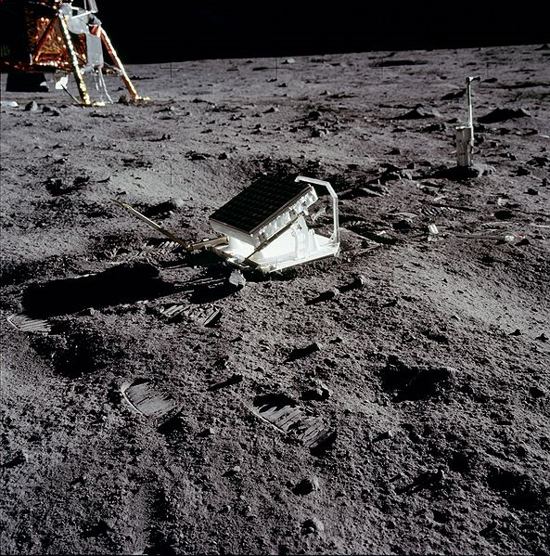
Landmarks: Retroreflector

Slide 18
Landmarks: Active Light

Slide 19
Trilateration
uses distance measurements to two or more landmarks
suppose a robot measures the distance d₁ to a landmark
the robot can be anywhere on a circle of radius d₁ around the landmark
d₁
landmark

Slide 20
Trilateration
without moving, suppose the robot measures the distance d₂ to a second landmark
the robot can be anywhere on a circle of radius d₂ around the second landmark
d₁
d₂
landmark
landmark

Slide 21
Trilateration
the robot must be located at one of the two intersection points of the circles
tie can be broken if other information is known
d₁
d₂
landmark
landmark

Slide 22
Trilateration
if the distance measurements are noisy then there will be some uncertainty in the location of the robot

Slide 23
Trilateration
notice that the uncertainty changes depending on where the robot is relative to the landmarks
uncertainty grows quickly if the robot is in line with the landmarks

Slide 24
Trilateration
uncertainty grows as the robot moves farther away from the landmarks
but not as dramatically as the previously slide

Slide 25
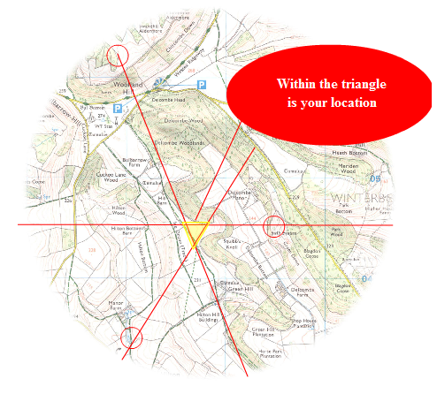
Triangulation
triangulation uses angular information to infer position
http://longhamscouts.org.uk/content/view/52/38/

Slide 26
Triangulation
in robotics the problem often appears as something like:
suppose the robot has a (calibrated) camera that detects two landmarks (with known location)
then we can determine the angular separation, or relative bearing, α between the two landmarks
known
position
D₁
known
position
Z₁
Z₂
α
unknown
position

Slide 27
Triangulation
the unknown position must lie somewhere on a circle arc
Euclid proved that any point on the shown circular arc forms an inscribed triangle with angle α
we need at least one more beacon to estimate the robot’s location
known
position
D₁
known
position
α
α

